Slide 1
Course: Professional Issues in IT
Course Instructor: Kashan Hussain
Email address: Kashan.Hussain@nu.edu.pk
Lec # 6

Slide 2
Professional Bodies in Computing: BCS
EDUCATION:
The BCS promotes education in a number of ways:
Professional examinations, approval to suitable organizations that provide courses to prepare students for them.
It accredits degree programs offered by institutions of higher education.
It sets the syllabus and accredits training organizations to provide the associated short courses.

Slide 3
BCS—Education—The professional examinations
Introduced in 1973
Purpose: to recognize skills and lead to qualify for membership
Stages: the Certificate, the Diploma, and the Professional Graduate Diploma.

Slide 4
BCS—Education—Accreditation and exemption
Accreditation means that a course has fulfilled the educational requirement
A course may qualify for full or partial exemption from the Higher Education Qualifications (HEQ), and students graduating from such courses can attain Professional Membership after a shortened period of relevant experience and training

Slide 5
BCS—Education—Short courses
BCS offers a substantial range of qualifications achievable through short courses. The courses are intended as training courses for staff working in the industry.

Slide 6
BCS—CONTINUING PROFESSIONAL DEVELOPMENT
In October 1994, the Engineering Council defined continuing professional development (CPD) as:
“The systematic maintenance, improvement and broadening of knowledge and skill and the development of personal qualities necessary for the execution of professional and technical duties throughout the individual’s working life.”

Slide 7
BCS—CONTINUING PROFESSIONAL DEVELOPMENT—activities
CPD services to individual members
Computer Bulletin ,keeping up-to-date info of latest computer areas and development
Career development and CPD services to the industry
Resolving IT staff issues of placement in the industry and training

Slide 8
BCS—THE ADVANCEMENT OF KNOWLEDGE
One of the first actions of the BCS when it was formed was to establish The Computer Journal.
The first issue was published in 1958 and it has been published regularly ever since.
Currently, six issues a year are published.

Slide 9
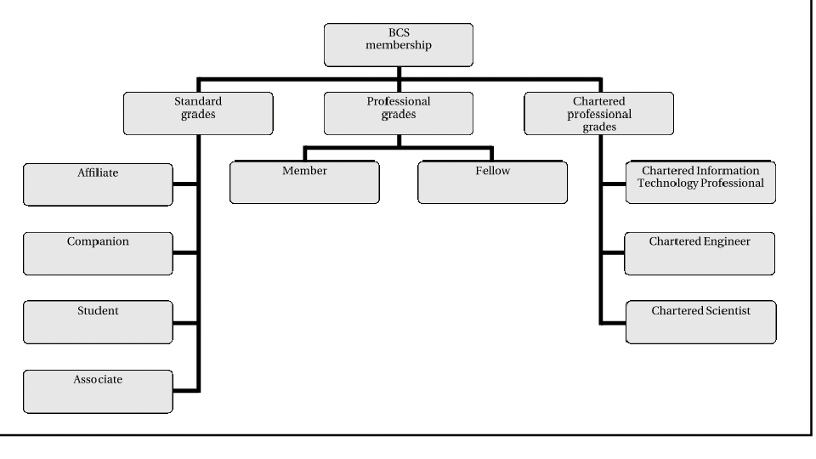
BCS—MEMBERSHIP GRADES

Slide 10
BCS—MEMBERSHIP GRADES
The standard grades:
Affiliate: open to anyone with an interest
Companion: members of other professional bodies with at least five years’ work experience related to information systems
Student: open to those following an approved course of study leading to a qualification recognized for admission to Associate or Professional membership of the Society.
Associate: Associate membership is open to anyone who has any of the following:
more than one but less than five years of IT work experience;
a Higher National Certificate in an IT-related field;
a non-accredited degree with a significant IT content.

Slide 11
BCS—MEMBERSHIP GRADES….
The professional grades
Membership: In order to qualify for membership in the professional grades, you must have one of the following:
the BCS Professional Graduate Diploma including the project;
an honours degree that gives you full exemption from the BCS examinations;
five years of relevant professional IT work experience;
some combination of academic qualifications and professional IT work experience that is judged to be equivalent to one of the above.
Fellow: Fellow is the most senior professional grade. It is open to applicants who can demonstrate a minimum of five years IT practitioner experience, senior post and authority in that field.

Slide 12
BCS—MEMBERSHIP GRADES….
The chartered professional grades
Member or Fellow holding the BCS Professional Graduate Diploma including the project or an honors degree that gives you full exemption from the BCS examinations and you must have five years of relevant professional IT work experience.
The Professional Advice Register
It maintains a register recording their members in relevant areas

